Slide 1

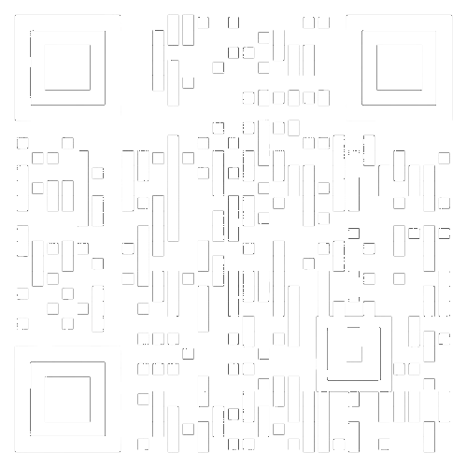
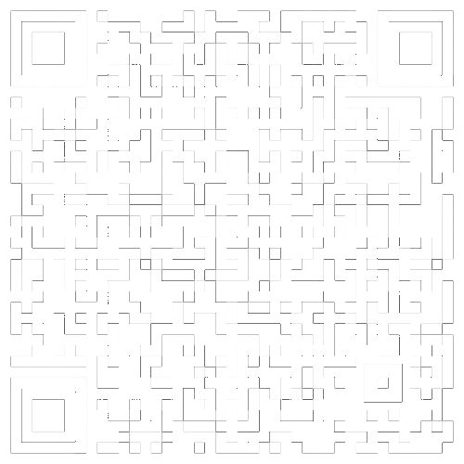
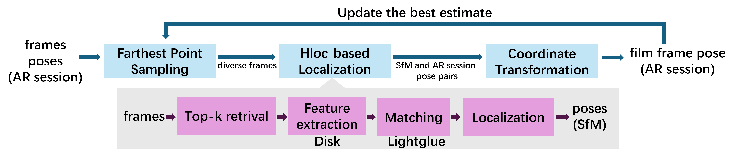
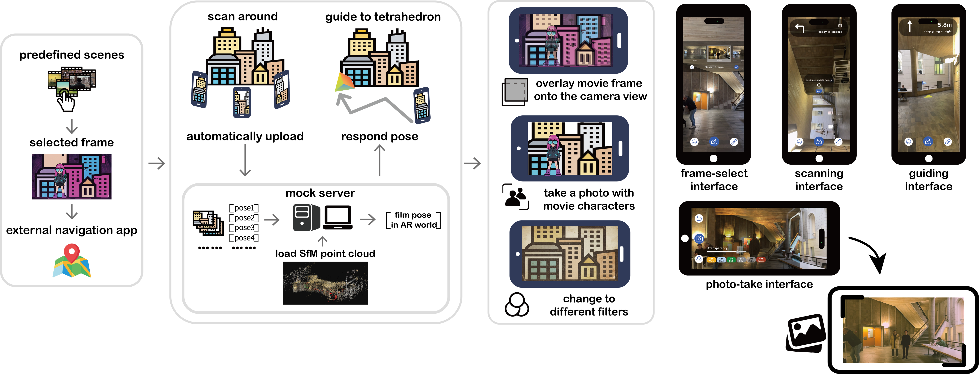
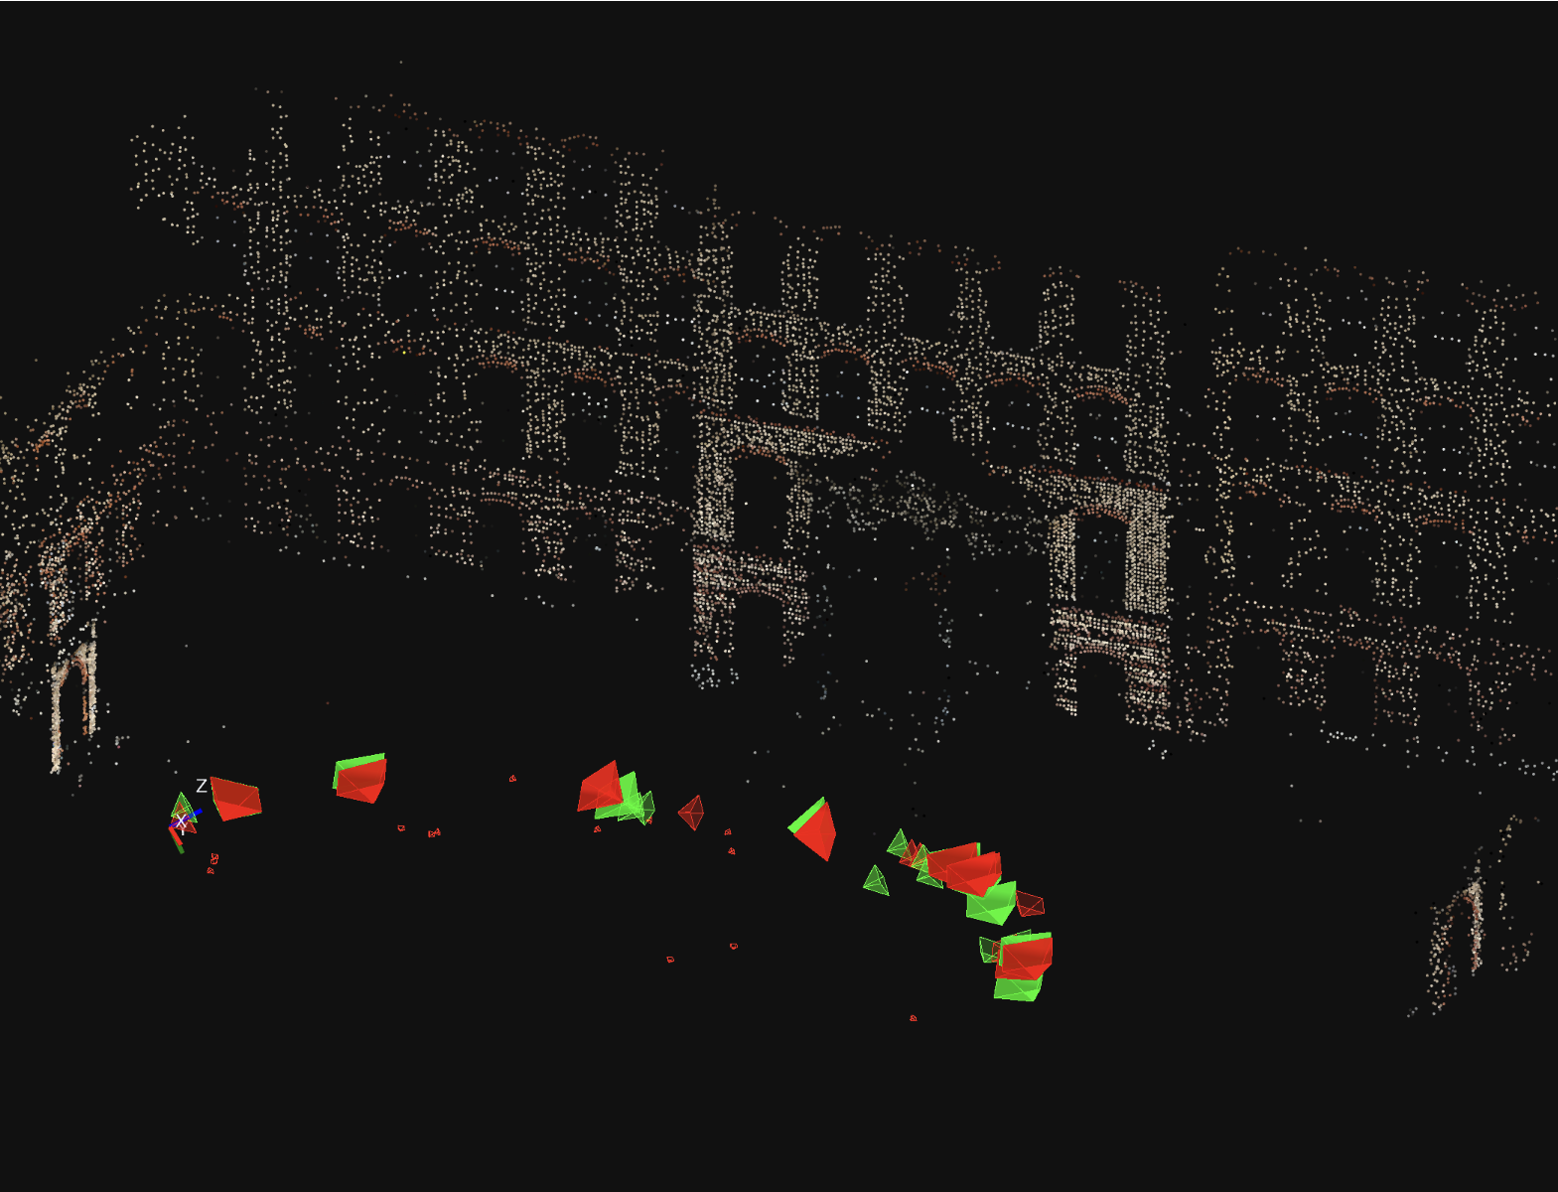
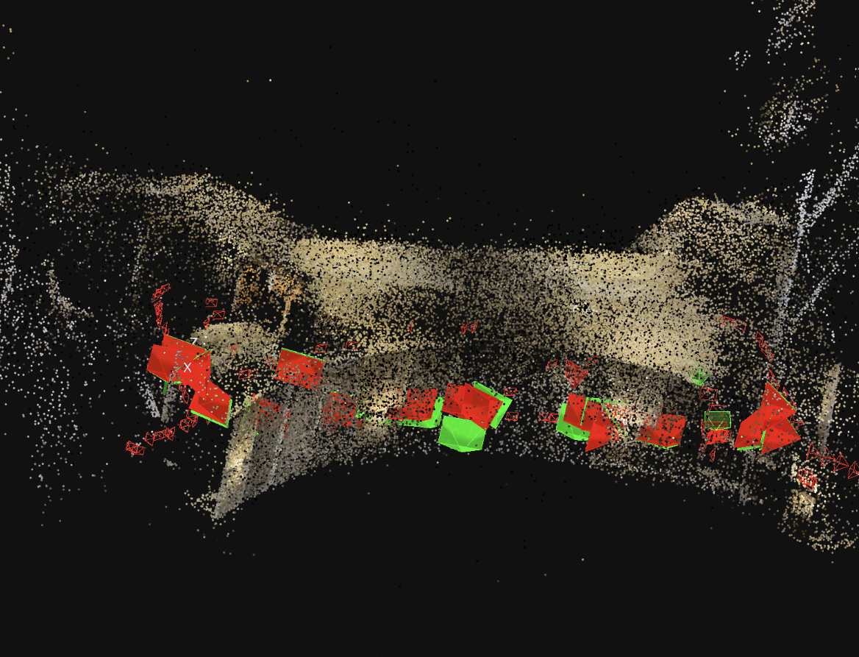
AR Journey into Movies
Junyi Huang¹, Li Wa Tang², Yiwei Pang¹, Zhihao Cai¹
Supervisor: Xudong Jiang³
¹D-BAUG, ETH Zurich; ²D-MAVT, ETH Zurich; ³D-INFK, ETH Zurich
^{Questionnaire}
^{Video}
INTRODUCTION
METHOD OVERVIEW
AR Journey Into Movie is an AR software to let users step directly into real-world film scenes. Choose a movie frame, scan the environment, and the system precisely aligns the original shot in AR. Users can navigate to the scene, view perfectly overlaid frames, take photos with characters, and apply creative camera filters for an immersive cinematic experience.
Tech Stack: Unity(C#), Python;
Platform: IOS
Database: We captured real-world images from two simulated film locations and built Structure-from-Motion(SfM) models using HLOC pipeline with DISK features.
Localization: In the multithreaded server, one worker processes incoming frames while another selects keyframes via Farthest Point Sampling (FPS). Pre-computed SfM models in the server are used to localize keyframes with HLOC [1], yielding SfM poses for estimating the sRt transform. The frame is then transformed into the AR session for accurate alignment.
CORE FLOW
^{server}
KEY RESULTS
CONCLUSION
To better estimate the global alignment transformation between the AR session and SfM frames, only geometrically consistent pose pairs are retained through a RANSAC-based filtering step. Larger opaque frustums denote the selected inlier pairs, whereas smaller frustums correspond to frames rejected due to inconsistency or ARKit/ARCore drift.
We built an AR mobile application that guides users to recreate movie shots at real-world filming locations.
Robust sRt estimation compensates for ARKit/ARCore drift, enabling reliable shot reproduction across diverse environments.
The system integrates cinematic color filters and AR character overlays, offering an immersive and engaging on-site experience.
References
Outdoor scene average position deviation = 0.748 m, rotation deviation = 5.01°.
Indoor scene average position deviation = 0.567 m, rotation deviation = 0.84°.
[1] Paul-Edouard Sarlin, Cesar Cadena, Roland Siegwart, and Marcin Dymczyk. From coarse to fine: Robust hierarchical localization at large scale. arXiv preprint arXiv:1812.03506, 2019.

